Slide 1

The Future Water Story
Pre-visit lesson

Slide 2
Teacher Instructions
Pre-visit: Introduction Lesson
Length: Approximately 60 minutes
Description: Students participating in the Future Water Story at the Western Treatment Plant, will explore the theme:
How can we manage Melbourne’s water sustainably as a valuable renewable resource?
This lesson is aimed at preparing your students for their visit to the Western Treatment Plant. It includes key content and terms to help them participate in the Future Water Story.
Optional extra lesson: Western Treatment Plant – GIS map lesson (Length 60 minutes)
***See Notes on each slide for more teaching notes and ideas***

Slide 3
Learning outcomes
Using this teaching guide and participating in the excursion, the students will learn how to:
Analyse water as a renewable resource - Students investigate how water functions as a renewable resource, understand that it is a scare and finite resource, and how water scarcity impacts liveability and sustainability
Collaborate to develop solutions to environmental challenges - Students apply teamwork, communication and conflict‑resolution strategies while proposing sustainable actions to improve liveability and environmental outcomes.
Use critical and creative thinking to design sustainable cities - Students collaboratively design a future city using digital tools, applying systems thinking, evaluating competing claims, and selecting criteria to guide decision‑making
Evaluate ethical and social implications of sustainability decisions - Students consider how values, worldviews and ethical perspectives influence decisions about water, waste, liveability and environmental management.
Notes:
Teaching notes & ideas:
You could add how population growth and climate change will impact water security in Melbourne.
The focus of the Future Water Story is on Melbourne, you could add reference other cities around the world if relevant.

Slide 4
Instructions
The following is a suggested sequence of activities and time allocation. You might want to spend more or less time on specific sections depending on your class and their learning requirements. All resources can be edited to suit your teaching needs.
Slide | Description | Time
Section: Preparing for your visit
1.1: Introduction | Introduction to main themes students will investigate | 6 minutes
1.2: Future Water Story | Introducing the challenge and the teams | 4 minutes
1.3: The teams | Allocating your students into groups | 4 minutes
Section: Key knowledge
1.5: Water supply catchments | What is a catchment? | 5 minutes
1.6: Melbourne's water supply system | Where does our water come from? | 5 minutes
1.7: Sewage | What happens to our wastewater? | 5 minutes
1.8: Water scarcity | What is water scarcity (physical and economic)? | 5 minutes
1.9: Securing our water supply | What might water sustainability look like, including an overview of alternate water sources | 6 minutes
1.10: Sustainability | What is sustainability? Use the definitions from the Victorian Curriculum | 5 minutes
1.11: Pillars of Sustainability | What are the social, economic, and environmental aspects? | 5 minutes
Section: Glossary of terms | Glossary | Reference

Slide 5

1.1: Introduction
How can we manage Melbourne’s water sustainably as a valuable renewable resource?
Where does water come from? Watch the video.
Notes:
Teaching notes & ideas
The next two slides are aimed at getting your students ready and excited to participate in the Future Water Story.
Teaching notes & ideas
Explain to students that they'll be visiting the Western Treatment Plant to participate in the Future Water Story and that they will be exploring the theme: How can we manage Melbourne’s water sustainably as a valuable renewable resource?
You could begin with a quick discussion about what students know about the Western Treatment Plant and why it is important:
Do you know where the Western Treatment Plant is located?
Have you ever visited the Western Treatment Plant?
Do you know any facts about the plant?
What would happen if you flushed the toilet, and it didn't work?
Key terms students should know to get the most out of the experience – see Glossary. The terms students will need to know include
Grey water
Ponds
Run-off
Activated sludge
Reservoir
Sewage
Sewerage
Stormwater
Wastewater
Water cycle
Desalination
Biosolids
Biogas
Drought
Dam
Water scarcity

Slide 6
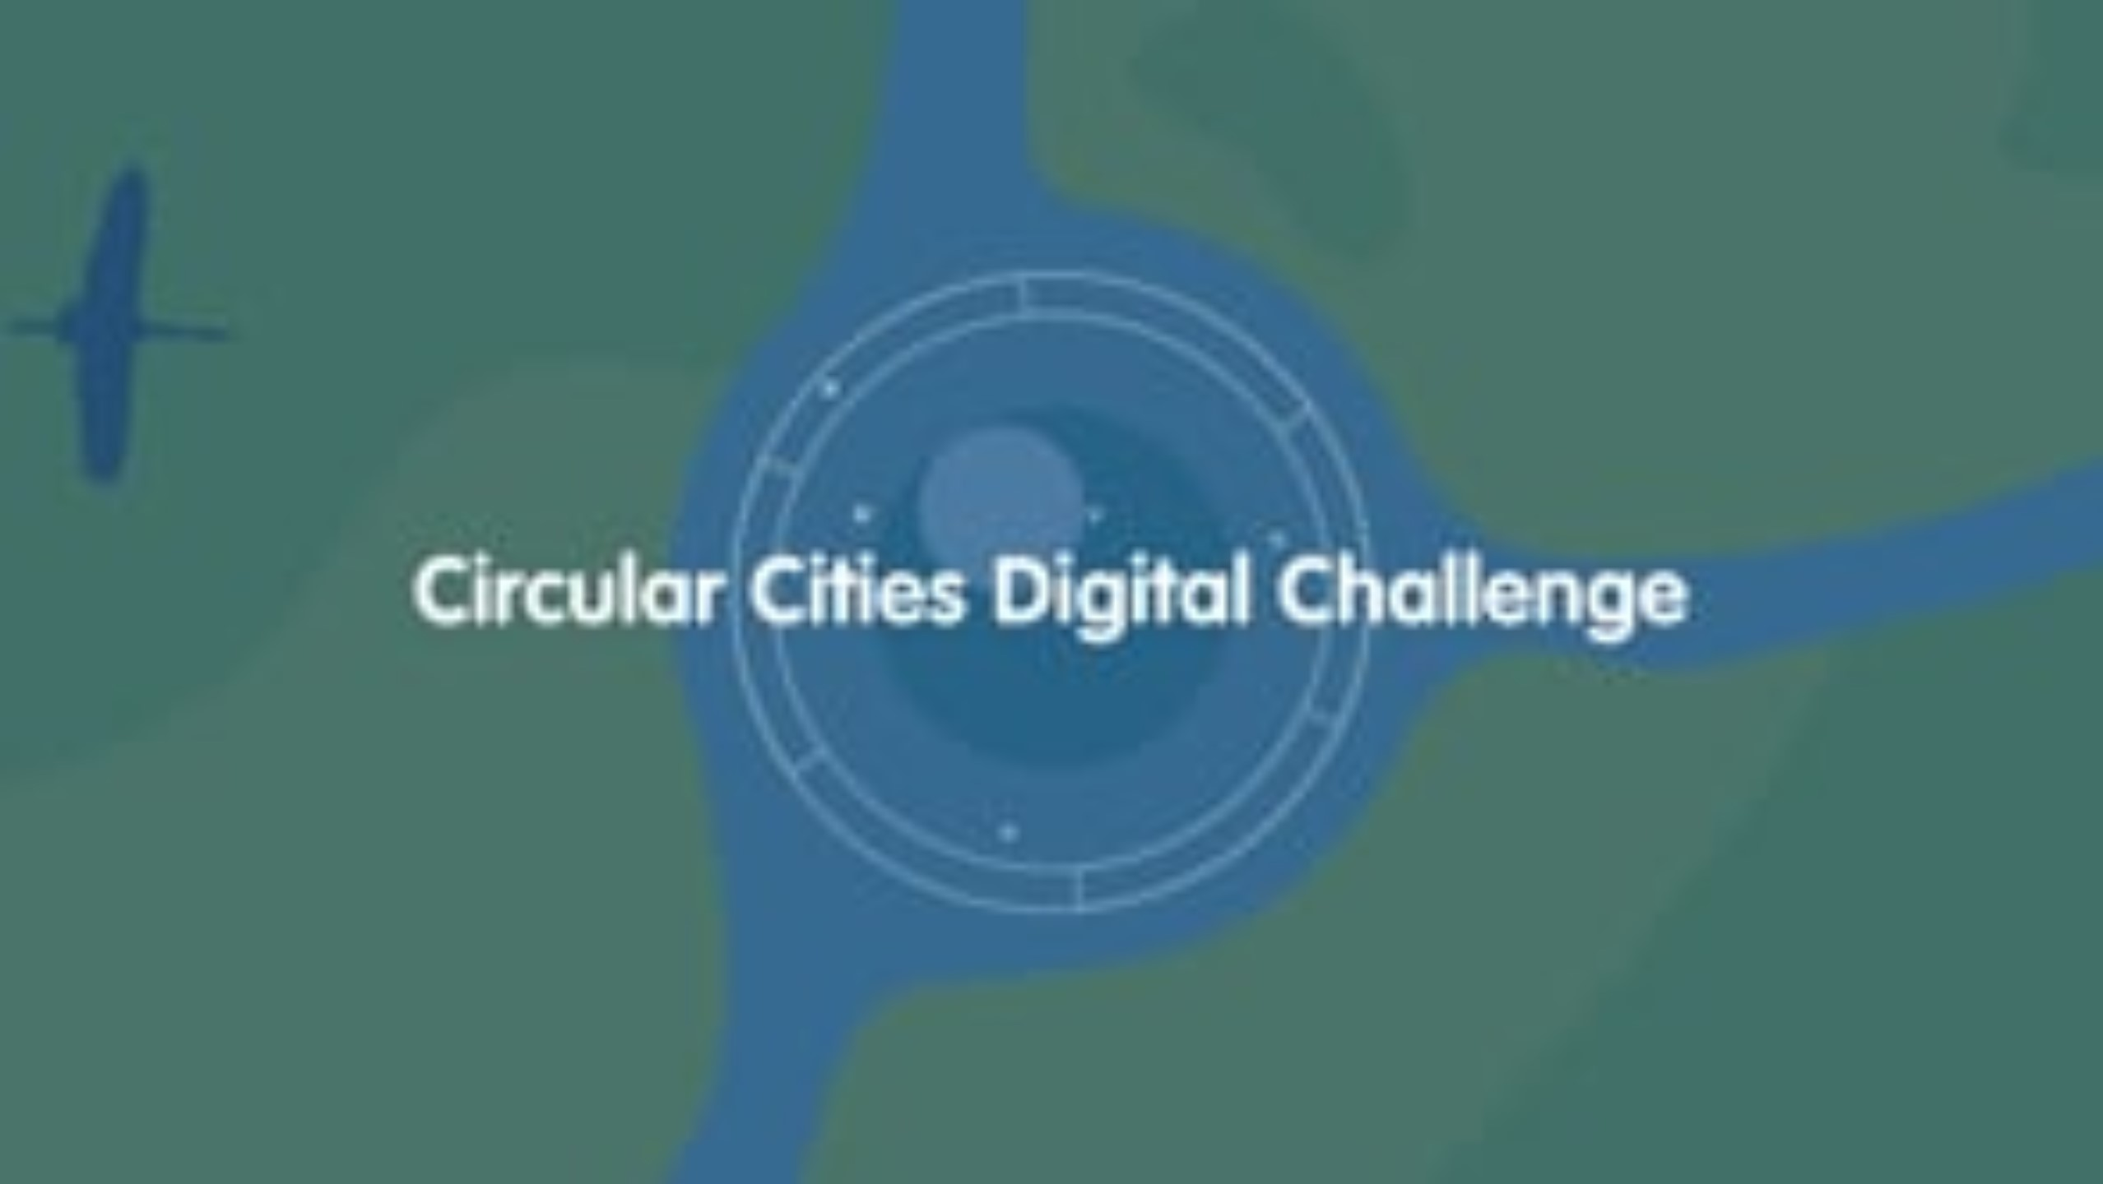
1.2: Future Water Story – Introducing the challenge & stakeholders!
Notes:
Teaching notes & ideas
Watch the video
Your students need to be allocated into teams. You may choose to allocate students or get them to nominate the group they would like to be part of. When students are participating in the challenge, they will need to consider the ‘needs’ and ‘requirements’ of their group.
The groups:
Banksia Sports
Culture Ark
Collins Family Farm
Creekside Science
Wattle School P&F
Health & Hue

Slide 7

1.3: Future Water Story – stakeholder groups!
Notes:
Teaching notes & ideas
Your students need to be allocated into different stakeholders. You may choose to allocate students or get them to nominate the group they would like to be part of. When students are participating in the challenge, they will need to consider the ‘needs’ and ‘requirements’ of their group.
The groups:
Banksia Sports
Culture Ark
Collins Family Farm
Creekside Science
Wattle School P&F
Health & Hue

Slide 8
Key knowledge
Notes:
Teaching notes & ideas
The next slides outline the key terms and concepts that will be discussed and covered as part of the Future Water Story.

Slide 9
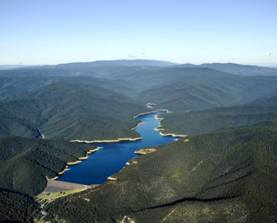
1.5: Water supply catchments
What is a water supply catchment?
A drinking water supply catchment is an area of land where water is collected by the natural landscape.
When it rains, water moves over the land and can find its way
into the ground
into streams or rivers
absorbed by plants
evaporated back into the atmosphere.
Water that flows into rivers and creeks can be stored in reservoirs that supply Melbourne with water.
Upper Yarra Reservoir
Notes:
Teaching notes & ideas
To explore the theme of using water sustainably, students first need to know where the water from their tap comes from. Some students might know that water is stored in reservoirs, but they need to know about catchments, and the importance of catchments to Melbourne’s ‘drinking’ water supply.
Explain to students that his images shows the Upper Yarra Reservoir and the land surrounding the reservoir forms part of Melbourne's water supply catchments. This is where the majority of Melbourne’s drinking water comes from and these areas are protected, meaning that there is limited public access.
Point and note the following
The dam wall at the bottom of the image and the reservoir of water behind the dam wall
Note the Yarra River that continues after the dam wall, and also point the river at the top of the reservoir
Rain that falls in this area is part of the Yarra Catchment. Rain falls to the ground, moves over the land and is absorbed into rivers and creeks.
Rain will also seep into the ground as groundwater. Some of this water then will seep into the rivers and creeks
This area is a closed catchment, meaning it is protected and there no or limited public access.
For more information
this video outlines the importance of protected catchments Why Melbourne’s drinking water is so good on Vimeo (see first 45 seconds)
Water catchments | Melbourne Water

Slide 10
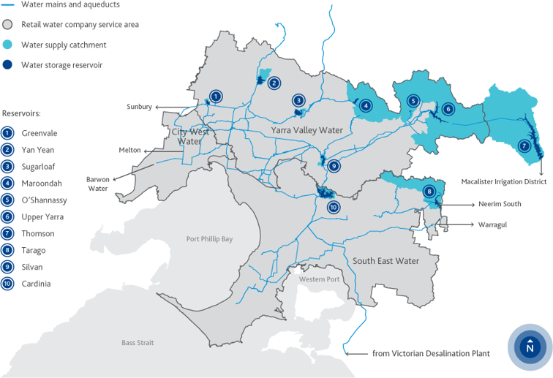
1.6: Melbourne’s water supply system
Notes:
Teaching notes & ideas
The previous slide showed the Upper Yarra Reservoir, you can point to the location of this map which outlines Melbourne's water supply system. For details about current water storages at each reservoir see Water storage levels | Melbourne Water
Explain to students the location of water supply catchments which are all to the east of Melbourne. Note the location of the reservoirs and the main network of pipes transporting water all over Melbourne.
You could show students this video which explains how Melbourne Water transfers water between reservoirs Transferring water between our water storage reservoirs

Slide 11

1.7: Sewage
Notes:
Teaching notes & ideas
To explore the theme of using water sustainably, students need to know what happens to their wastewater and where it goes. Watch the video for a brief explanation.
Remind your students of the importance of sanitation and a sewerage network. You could discuss why Melbourne was once known as 'Smellbourne' and the health impacts (cholera and typhoid) of untreated sewage. Hundreds of people died from a savage typhoid outbreak in the 1880s due to the incorrect disposal of animal and human waste.
Get students to write down notes about what happens to their sewage and how it is reused. Ensure they write down the following information, which will help them respond to the theme of using water sustainably.
Recycled water – firefighting, watering gardens, toilets
Biogas – powering the site, sending back to the grid
Biosolids* is a product of treating sewage not mentioned in the video, which will be discussed on the visit to the WTP. For more information go to the Melbourne Water website and search for ‘Where your sewage goes’.
See GIS map lesson* (optional)
Navigate a GIS map of Melbourne and learn about the sewerage and water supply network

Slide 12
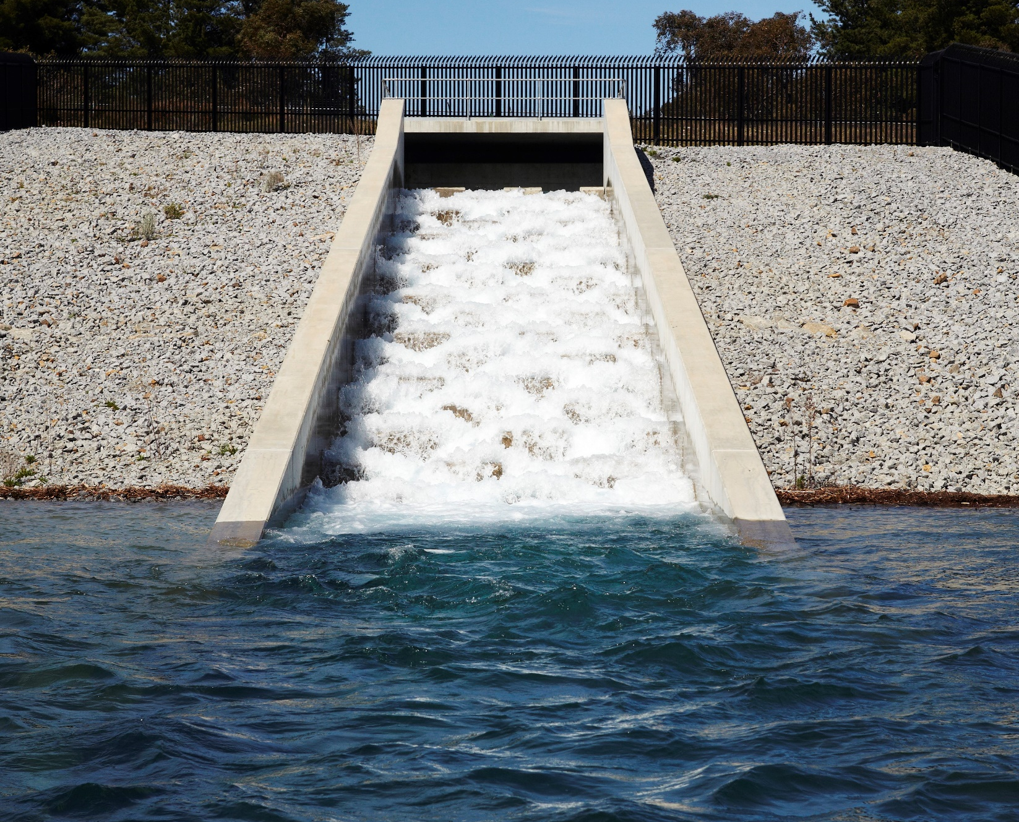
1.8: Water Scarcity
What is water scarcity?
Water scarcity occurs when the demand for water exceeds the amount available.
Types of water scarcity
Physical: is when there is a drought and there is not enough water to meet all demands, for people and the environment
Economic: is when there has not been enough investment in the infrastructure needed to store and transport water to where it is needed.
Notes:
Teaching notes & ideas
The image shows Cardinia Reservoir, which is Melbourne’s second-largest reservoir.
Water scarcity can lead to water stress, which is the negative effects a lack of water has on the environment, the economy and society.
Ask students to note these definitions.
This section focus on the supply of water; you could also get students to consider wider impacts of water scarcity.

Slide 13
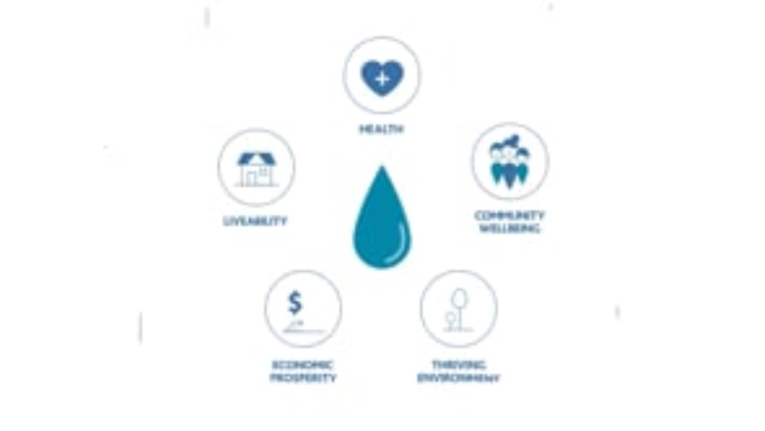
1.9: Securing our water supply
Notes:
Teaching notes & ideas
Watch the video and get students to write notes about
The Millennium Drought and its impact on Melbourne’s water supply, where water supplies decreased by 20% in a single year
A buffer in our water system to protect against the next drought and in case of bushfires
Climate change is affecting our water supply, winter and spring are becoming drier and rainfall more variable
We’ve got better at conserving and using less water, but our population is increasing
Can not build more dams because less rainfall means they won’t fill
We learnt about that severe water restrictions can impact our quality of life
We’re working to extend the use of recycled water and more stormwater harvesting
The desalination plant to rebuild and maintain a buffer of water in the system

Slide 14
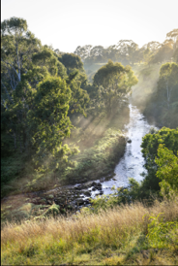
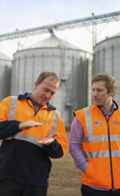
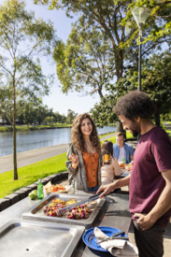

1.10: Sustainability
What is sustainability
Sustainability means 'meeting the needs of the present without compromising the ability of future generations to meet their own needs, focusing on the ongoing capacity of Earth to maintain all life' (Victorian Curriculum definition).
Sustainability incorporates at least 4 pillars:
Environmental
Economic
Social/Emotion
Cultural
Notes:
Teaching notes & ideas
To respond to the theme How can we manage Melbourne’s water sustainably as a valuable renewable resource?
Students will need to understand the concept of sustainability and its four pillars. You can use the definitions from the Victorian Curriculum Geographical Concepts and the Cross-Curriculum Priority.
Get students to write down this definition and answer the questions on the next page.

Slide 15
1.11: How can we manage Melbourne’s water sustainably as a valuable renewable resource?
Think about the four pillars of sustainability. How can we take this into consideration when thinking about Melbourne’s water supply and sustainable use?
What can we do to manage Melbourne’s water sustainably from an environmental aspect? | What can we do to manage Melbourne’s water sustainably from an economic aspect? | What can we do to manage Melbourne’s water sustainably from an emotional/social aspect? | What can we do to manage Melbourne’s water sustainably from a cultural aspect?
Notes:
Teaching notes & ideas
What can we do to manage Melbourne’s water sustainably from an environmental aspect?
What can we do to manage Melbourne’s water sustainably from an economic aspect?
What can we do to manage Melbourne’s water sustainably from an emotional/social aspect?
What can we do to manage Melbourne’s water sustainably from a cultural aspect?
Note: The Future Water uses the term ‘Emotion’.
Extension: Have students think about any other pillars that might be important to sustainability – is there more than four? Students may think of other pillars that they think are important such as health or education. Have them design their own ‘pillars of sustainability’

Slide 16
Are you ready for the
Future Water Story?

Slide 17
Glossary
Word | Definition
activated sludge process | A sewage process in which solids are separated from wastewater using bacteria and aeration. Organisms such as bacteria degrade organic material and remove nutrients using oxygen before they are separated from the treated water
aerator | A device for mixing air into the sewage
aerobic | a process which requires oxygen. In sewage air is mixed into the sewage to encourage certain bacteria to help break down the waste
anaerobic | This is a process which does not require oxygen. In this case some bacteria work without oxygen to help clean the waste
aquifers | layers of rock that can store large quantities of water
Biogas | a renewable energy resource produced by micro-organisms such as methanogens
biosolids | a sludge by-product of the sewage treatment process. Some of this is nutrient- rich and can be reused for many purposes including agricultural use or energy production
blue water | fresh surface water and groundwater, such as lakes, rivers and aquifers
brine | a very salty solution
catchment | an area of land where water (from precipitation) is collected by the natural landscape. The water then flows or drains into rivers, creeks, dams, lakes or into a groundwater system
dam | a structure built across a river to control the river’s flow and create a reservoir (lake)
desalination | the removal of salts from seawater or other saline (salty) solutions
drainage basin | the area where water collects and moves towards a river and its tributaries (branches of water from the main river; also known as a catchment or river basin
drought | a prolonged (lengthy) period of below-average rainfall
groundwater | water beneath the Earth’s surface that fills pores or tiny spaces in materials such as sand, soil or gravel
green energy | energy (electricity) produced using renewable resources, such as wind or sunlight, without creating greenhouse gases
green water | the precipitation (rainfall) on land that does not run off or become groundwater, but is stored in the soil or temporarily stays on top of the soil or in vegetation

Slide 18
Glossary of terms that might be used on your excursion
Word | Definition
grey water | water generated from domestic activities such as washing clothes, dishwashing and bathing
heatwaves | short periods (usually no longer than a few days) of well-above-average temperatures
non-potable | water that is not safe to drink but can be used for other purposes
ponds/ lagoons | large ponds for treating the sewage. The sewage flows through the ponds, gradually becoming cleaner as bacteria break down the organic matter in the water
potable | water that is safe to drink
river basin | land that acts as a container for water to flow towards a main river or ocean; also known as a catchment or drainage basin
run-off | the movement of surface water across the land and down slopes
reservoir | a large natural or artificial lake used as a source of water supply
sanitation | the infrastructure related to the collection and disposal of sewage (human waste)
sewage | the wastewater that leaves our kitchens, bathrooms, laundries and toilets, as well as from industry and businesses
sewerage | the network of pipes and pumps that carry away wastewater and human waste from houses and other buildings
stormwater | water from rain or storm events that flows off a house or building
virtual water | the volume of fresh water that is consumed (or polluted) when a product is created
wastewater | water that is discharged from homes and businesses and sent to the treatment plant
water allocation | the amount of water a water user with a water access licence is allocated against their licence in a water year/ A water allocation is an authority to take water, and an entitlement to a share of the available water resource in a catchment
water budget | an account of the water stored in a system, such as a watershed, and the movement of water in and out of that system. The equation used to calculate a water budget broadly includes precipitation, water flow into a system, water flow out of a system, changes in water storage, and evapotranspiration
water cycle | the processes of water passing from and to the Earth’s oceans, atmosphere and land
water footprint | the total volume of fresh water used by an individual, a household, a business, a community or a country
water scarcity | a situation in which the demand for water is greater than the amount available
watersheds | the boundaries between catchments
water stress | the negative effect that water scarcity can have on people and environments

